Slide 1
E-consent for Teenage Immunisations A step-by-step guide to completing the form

Slide 2
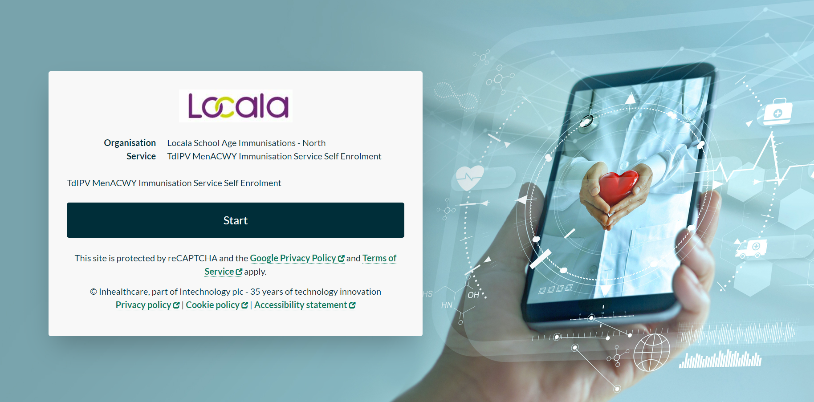
Click Start
IMPORTANT - this must be completed by the person(s) with parental responsibility for the child

Slide 3
Insert the code received via the link sent to you from school or SMS message
Then, click Submit

Slide 4
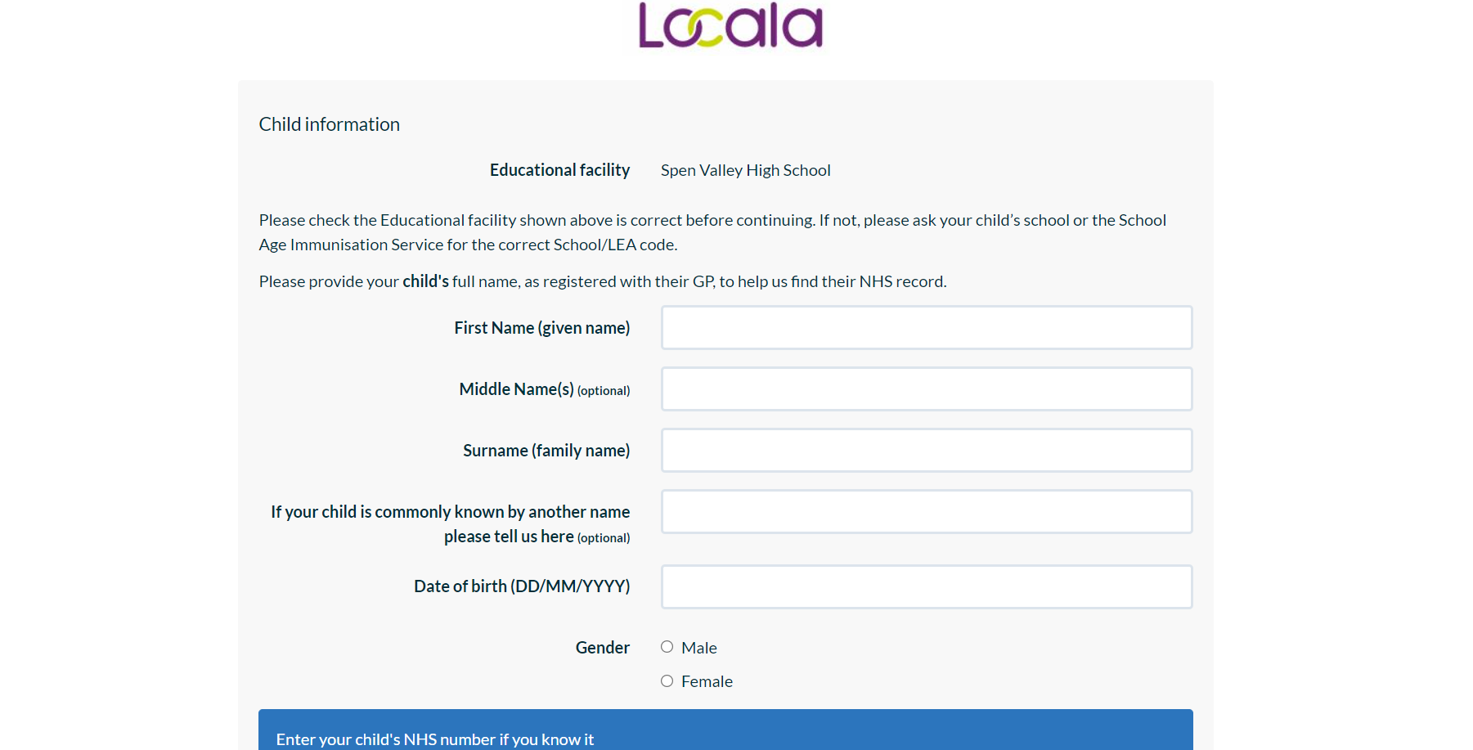
Complete your child’s details
(see next page for more information)
Add in your child’s school

Slide 5
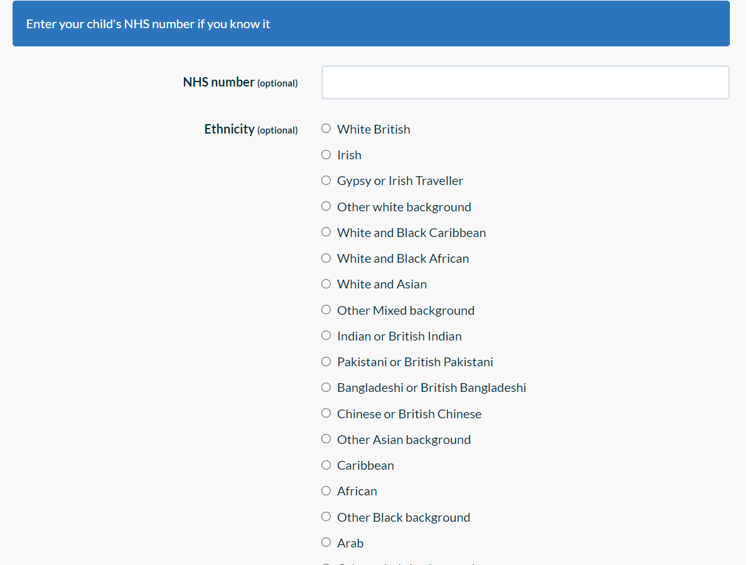
Select your child’s ethnicity, year group and full address
Then, click Submit

Slide 6
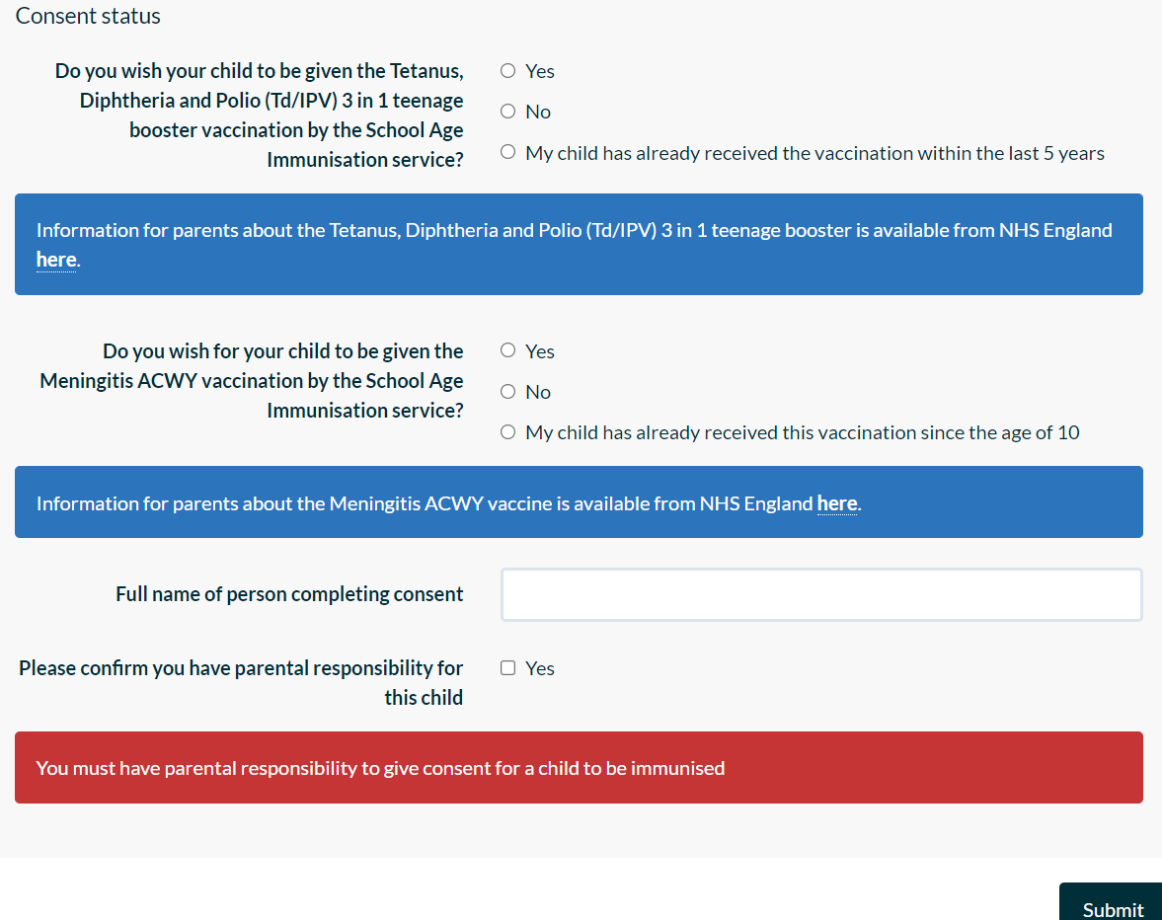
Indicate if you wish to give consent for the immunisations or decline
Fill in your full name
tick if you have parental responsibility
click Submit

Slide 7
Complete the contact details of the person completing this form
Then click Submit
You will then receive an email with a four digit code
(if you don’t see the message in your inbox, check your junk email folder)
If you are struggling to complete on a phone due to shutting down the form to get the verification code, try using two devices, complete the form on one device and receive the email with the verification code on the other device

Slide 8
Enter the four digit code from the email you have received
Then click Submit

Slide 9
Optional – if you want to, you can add another person with parental responsibility
click yes or no then select “Submit”

Slide 10
Medical questions – please answer all questions
Then click Submit

Slide 11
Confirmation screen will show all your answers
Please double check the information
Click ‘Yes’ to Submit
You will then receive an email with the date of the session
If you have mentioned any medical comments there may be a delay with receiving your confirmation email as these will need to be reviewed by an Immunisation Nurse.

